Slide 1

Movie rental data analysis
PUCHE
Mentored by: ashish rajput

Slide 2
CONTENTS
Objective
Introduction
Business Problems
Analysis
Conclusion

Slide 3
Objective
The objective of the project is to use MySQL to analyze the data of a ,movie rental store for further growth and improved business

Slide 4
INTRODUCTION
Movie rental data analysis involves examining and interpreting information related to the rental of movies.
In this exploration, we will analyze what kind of movies are most often rented, providing a deeper understanding of customer preferences, popular genres, and rental trends.

Slide 5
Business Problems
Display the full names of actors available in the database.
Display the number of times each first name appears in the database.
What is the count of actors that have unique first names in the database? Display the first names of all these actors.
3.
Display the number of times each last name appears in the database.
Display all unique last names in the database.
4.
Display the list of records for the movies with the rating "R".
Display the list of records for the movies that are not rated "R".
Display the list of records for the movies that are suitable for audience below 13 years of age.
5.
Display the list of records for the movies where the replacement cost is up to $11.
Display the list of records for the movies where the replacement cost is between $11 and $20.
Display the list of records for the all movies in descending order of their replacement costs
6. Display the names of the top 3 movies with the greatest number of actors.
7. Display the titles of the movies starting with the letters 'K' and ‘Q’
8. Display the names of all actors who appeared in the film “Agent Truman”.
9. Identify all the movies categorized as family films.
10.
Display the maximum, minimum, and average rental rates of movies based on their ratings. The output must be sorted in descending order of the average rental rates.
Display the movies in descending order of their rental frequencies, so the management can maintain more copies of those movies.
11. In how many film categories, the difference between the average film replacement cost ((disc - DVD/Blue Ray) and the average film rental rate is greater than $15?
Display the list of all film categories identified above, along with the corresponding average film replacement cost and average film rental rate.
12. Display the film categories in which the number of movies is greater than 70.

Slide 6
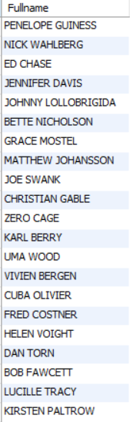
TASK 1: Display the full names of actors available in the database.
1
QUERY
OUTPUT
From the given output we found that there are a total of 200 actors.

Slide 7
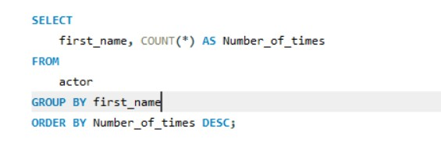
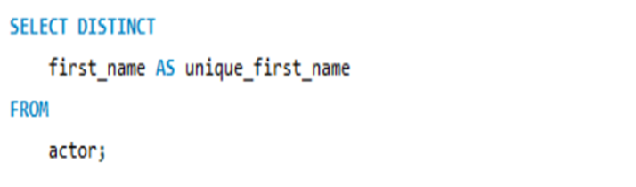
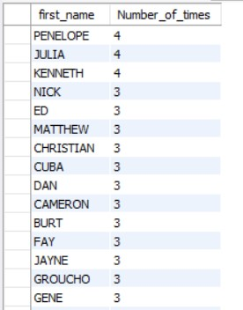
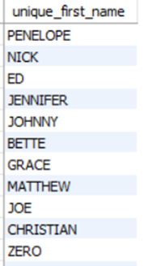
Display the number of times each first name appears in the database.
What is the count of actors that have unique first names in the database? Display the first names of all these actors.
2
QUERY
QUERY
OUTPUT
OUTPUT
The total number where each first name appears in the database are 4times .
They are Penelope ,Julia and Kenneth.
There are 128 actors that have unique first names.

Slide 8
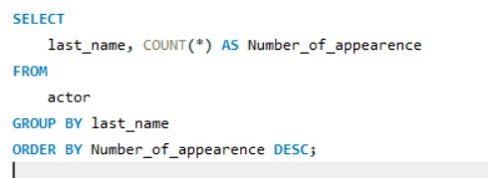
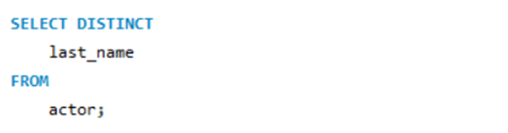
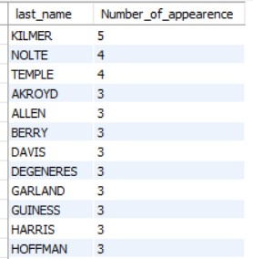
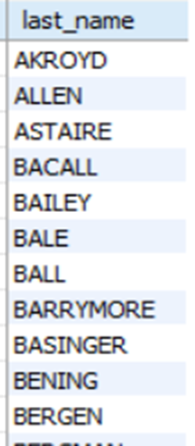
Display the number of times each last name appears in the database.
Display all unique last names in the database.
3
QUERY
QUERY
OUTPUT
OUTPUT
From the given output ,we found that, KILMER is the last name that appeared 5 times.
There are a total of 121 unique last names.

Slide 9


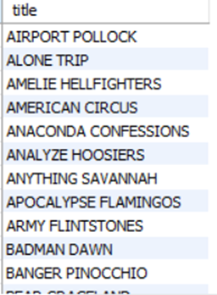
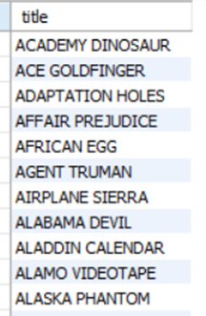
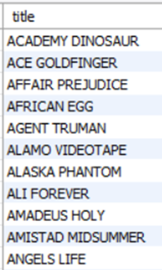
4
Display the list of records for the movies with the rating "R".
Display the list of records for the movies that are not rated "R".
Display the list of records for the movies that are suitable for audience below 13 years of age.
QUERY
OUTPUT
From the given output, There are a total of 128 movies that are rated ‘R’
There are a total of 805 movies that are not rated ‘R’
There are a total of 372 movies that are suitable for children below 13.

Slide 10



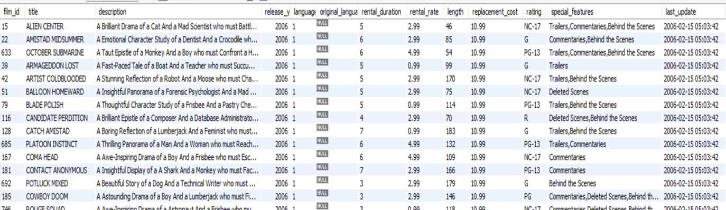
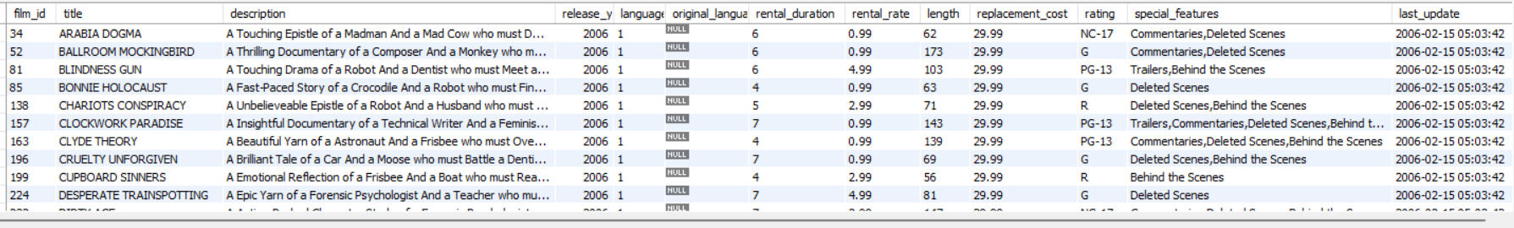
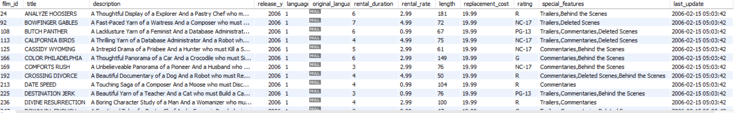
5
Display the list of records for the movies where the replacement cost is up to $11.
Display the list of records for the movies where the replacement cost is between $11 and $20.
Display the list of records for the all movies in descending order of their replacement costs
QUERY
I
II
III
OUT
PUT
OUTPUT
OUTPUT
There are a total of 90 movies whose replacement cost is upto $11
There are 424 movies where the replacement cost is between $11 and $20.
The highest replacement cost is 29.99 and movies like Arabia Dogma has the highest replacement cost.

Slide 11
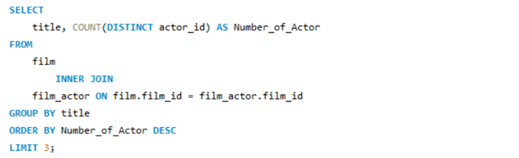

Display the names of the top 3 movies with the greatest number of actors.
6
QUERY
OUTPUT
From the output ,we found , the three movies with highest number of actors are: LAMBS CINCINATTI, CHIITY LOCK and BOONDOCK BALLROOM . With 15 as the number of actors in the movie LAMBS CINCINATTI .

Slide 12
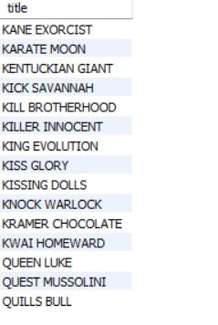
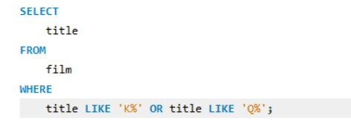
Display the titles of the movies starting with the letters 'K' and ‘Q’
7
QUERY
OUTPUT
There are 13 movies that starts with the title K.
There are 3 movies that starts with the title Q.

Slide 13
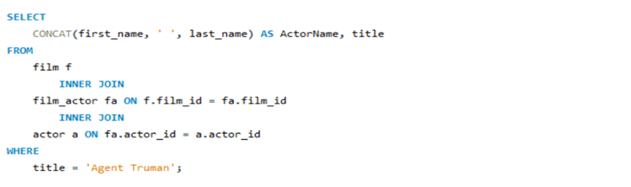
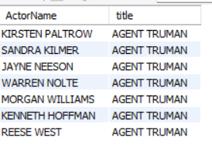
Display the names of all actors who appeared in the film “Agent Truman”.
8
QUERY
OUTPUT
There are 7 actors in the movies Agent Truman.

Slide 14

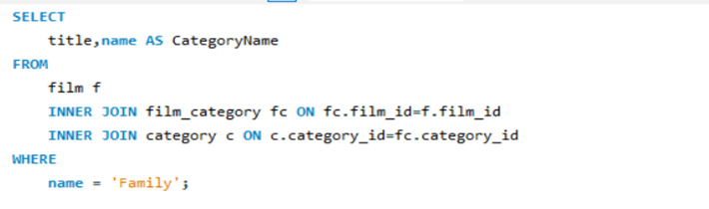
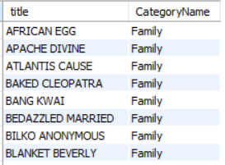
9
Identify all the movies categorized as family films.
QUERY
OUTPUT
There are 69 movies that are categorized under family films.

Slide 15
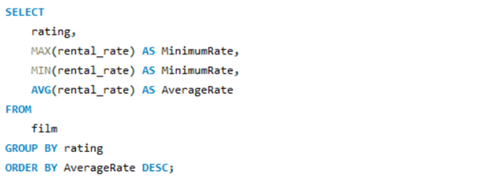
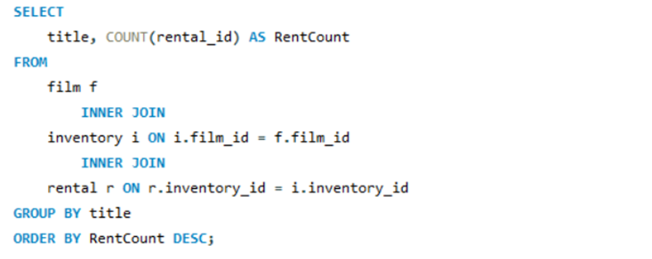
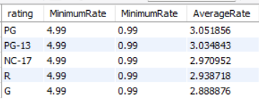
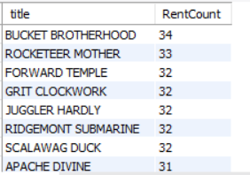
Display the maximum, minimum, and average rental rates of movies based on their ratings.
Display the movies in descending order of their rental frequencies.
10
QUERY
OUTPUT
PG rating has the highest average rating followed by PG-13 and so on.
The movie BUCKET BROTHERHOOD has the most number of rents (34 rents).

Slide 16
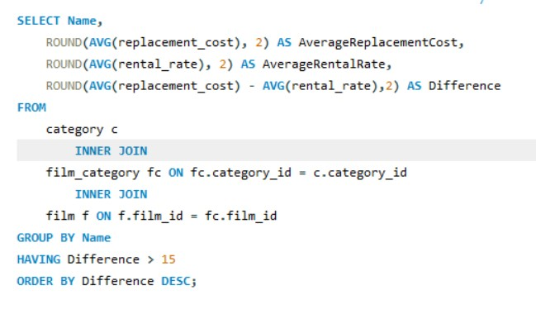
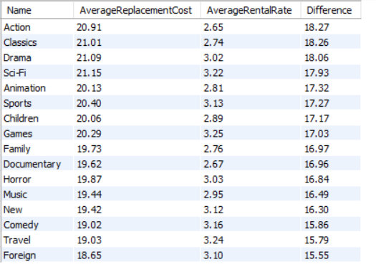
Display the list of all film categories identified above, along with the corresponding average film replacement cost and average film rental rate and sort the difference between them in descending.
11
QUERY
OUTPUT
After categorizing and sorting the differences along with the corresponding average film replacement cost and average film rental rate there are 16 movies as such.

Slide 17
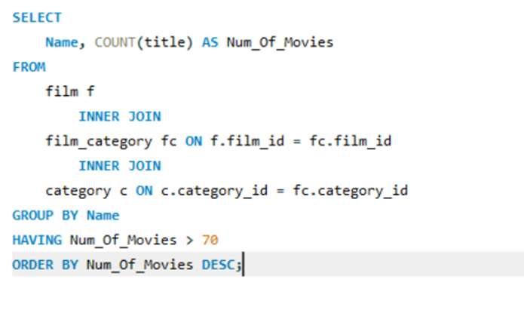

Display the film categories in which the number of movies is greater than 70.
12
QUERY
OUTPUT
The sports and Foreign are the only two category which have more than 70 movies.

Slide 18
Conclusion
There are 128 actors that have unique first names and 121 with unique last names.
There are 372 movies that are suitable for below 13 years age.
There are a total of 90 movies whose replacement cost is up to $11
There are 69 movies that are categorized under family films.
The sports and Foreign are the only two category which have more than 70 movies.

Slide 19
THANK YOU

